Slide 1
Problem Statement:
Develop a cryptography simulation tool using OpenSSL libraries with an interactive interface. Users can input images to visualize AES encryption and decryption processes.

Slide 2
Unique Idea Brief (Solution):
Our cryptography simulation tool specializes in image encryption and decryption using AES-128 CBC mode, focusing images for enhanced data security. The user-friendly command-line interface (CLI) ensures accessibility for users with varying levels of cryptographic knowledge.
A standout feature is the integration of certificate generation with OpenSSL, adding an extra layer of security and authenticity. Users provide encryption keys and initialization vectors (IVs) during decryption, reinforcing key cryptographic concepts.

Slide 3
Features Offered
1. Image Encryption :
Encrypts image files using cryptographic techniques.
2. Image Decryption:
Decrypts encrypted image files back to their original form.
3. Certificate Management:
Handles certificate generation and management for encryption and decryption.
4. Key Management:
Uses private and public keys for encryption processes.

Slide 4
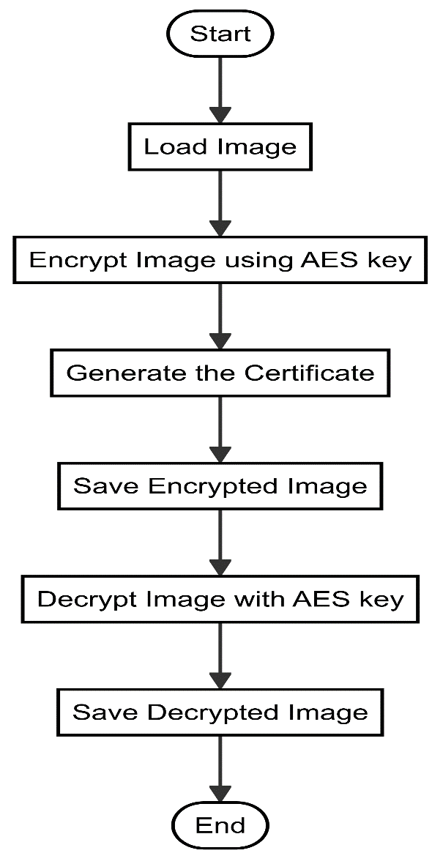
Process flow

Slide 5
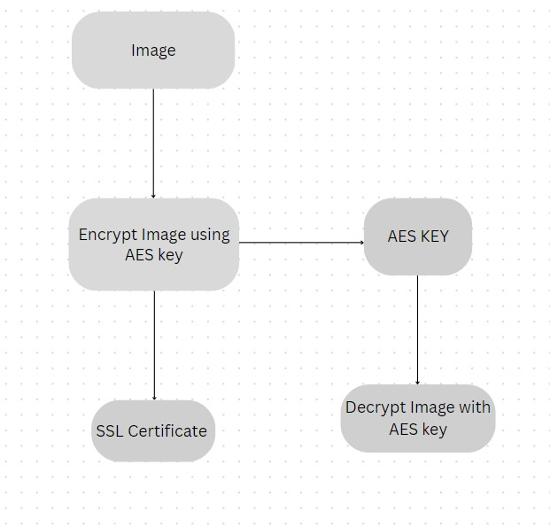
Architecture Diagram

Slide 6
Technologies used
Programming Languages and Libraries:
C++: Used as the primary programming language for implementing the tool's core functionalities.
OpenSSL: Employed for cryptographic operations such as AES-128 CBC mode encryption and decryption, as well as X.509 certificate generation.
Standard C++ Library (fstream): Utilized for reading and writing image files in binary mode, ensuring secure file handling during encryption and decryption processes.
Command-Line Interface (CLI): Developed using standard input/output operations in C++, providing an interactive interface for users to encrypt, decrypt, and manage image files.
OpenSSL Library: Integrated to generate X.509 certificates, enhancing security by providing authenticity and validation capabilities beyond basic encryption.
Microsoft Visual Studio: As the integrated development environment (IDE) for coding and testing the tool.

Slide 7
Team members and contribution:
Encryption, Decryption Modules and Image processing (Sirish and Shashank):
Implemented AES-128 CBC mode encryption and decryption for image data.
Ensured secure handling of image files and data integrity during encryption and decryption processes.
Module Integration and Command-Line Interface (Karuna):
Designed and developed the interactive command-line interface (CLI) for user interaction.
Implemented menu options for image encryption, decryption, and program exit.
Certificate Generation and Management (Isaaq):
Implemented X.509 certificate generation using OpenSSL.
Integrated certificate management functionalities for security and authenticity verification.
Key and IV Input Handling (sahana):
Developed functionality for user-provided encryption keys and initialization vector (IV) input during decryption.
Implemented validation and error handling for key and IV inputs to ensure cryptographic integrity.

Slide 8
Conclusion
Our cryptography simulation tool offers a robust solution for secure image encryption and decryption, leveraging AES-128 in CBC mode. With an interactive command-line interface, users can easily encrypt and decrypt images, supported by X.509 certificate generation for enhanced security. The tool emphasizes user-provided key and initialization vector input, reinforcing cryptographic principles. Planned performance metrics aim to educate users on encryption efficiency. Utilizing mbedTLS/OpenSSL ensures industry-standard security practices, while supporting an end-to-end workflow from image loading to encrypted storage and decryption. This comprehensive approach makes our tool an ideal choice for both practical application and cryptographic education.

